Slide 1





QC Benchmarker: a streamlined web application to comprehensively evaluate instrument performance and direct troubleshooting
Benjamin A. Neely
Paul E. Anderson
W. Clay Davis
Magnus Palmblad
Identification of certain commercial equipment, instruments, software or materials does not imply recommendation or endorsement by the National Institute of Standards and Technology, nor does it imply that the products identified are necessarily the best available for the purpose.

Slide 2



System Suitability – how you test is important
Metrics
Track speed
High-speed corners
Race Car
Track speed
Low-speed corners
High-speed corners
Braking
etc.
?
Modern Mass Spectrometer
Metrics
22k MS/MS
3552 PSMs
103 Peptide groups
77% coverage of BSA
BSA Digest
HeLa Digest
75k MS/MS
28,469 PSMs
21,689 Peptide groups
4140 Protein groups
Notes:
How do you know you your system is working properly before/during your analysis
Benchmarked relevant Sample – old days was BSA, now is HeLa
Key point, aside from obvious, is how you can run BSA on a poorly performing modern mass spec and get “good” values.
How do you evaluate?

Slide 3
Proteomics - System suitability sample and metrics
ID-based Metrics:
Detection of specific peptides
Rates of peptide identification
Coverage of known proteins
ID-free Metrics:
Peak width/shape
TIC
Mass error
Charge state distribution
…
etc.
Complex Digest:
HeLa
Yeast
E. coli
C. elegans
Arabidopsis
Basic metrics:
Ex.
75k MS/MS
28,469 PSMs
21,689 Peptide groups
4140 Protein groups
Determine whether system is working
… from LC to MS/MS
Communicate quality across time and labs

Slide 4
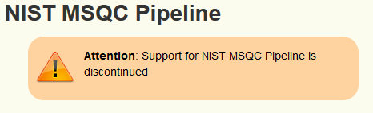




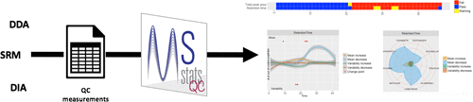
QC – the current toolset
ID-Free + ID-based
RawTools
QCQuan
PTXQC
QCMAP
Tools derived/inspired by MSQC:
MassQC
Metriculator
QuaMeter
pmartR
SIMPATIQCO Server
Specific application QC tools
TMT - TVT: Triple Knockout Proteome Standard Visualization Tool
Local and/or web-based versions
Can work on any lab’s QC sample
Some require the presence of predefined m/z
Can be used for quality controls within experimental runs
ID-Free only
spRoCoP - Statistical Process Control in Proteomics
Raw Beans
QC-ART
* this is not an exhaustive list, please excuse any omissions.
Notes:
MSQC:
46 quality metrics related to chromatography, ion source, MS1 and MS2, as well as peptide identifications

Slide 5
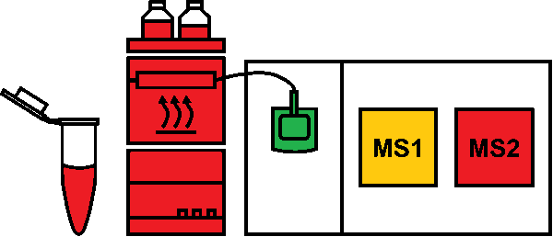
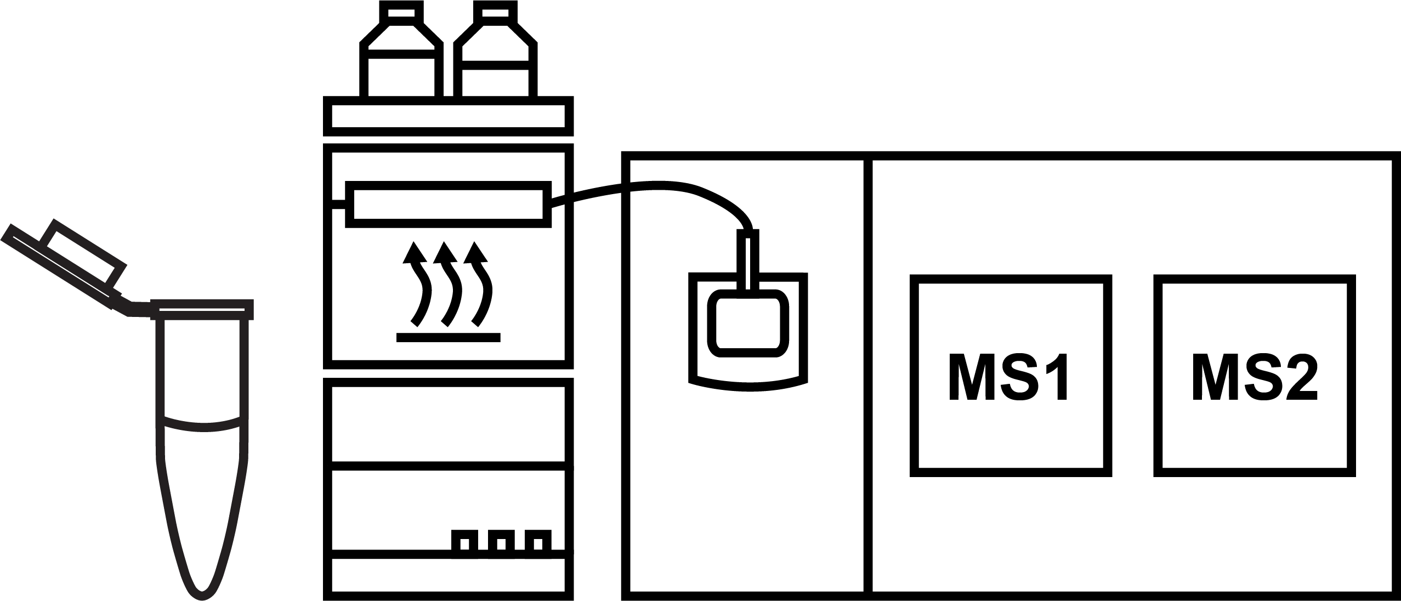

Yet another tool!!!
Focus on a weekly QC sample run (known sample, known conditions) for system suitability, so that metrics/reports can be made without user specified parameters.
?
Instead of plotting a predefined peptide or m/z across many datasets, we use machine learning to model the performance of the LC and the ion source, to give more actionable QC metrics for troubleshooting. We also strive to have one ID-based and one ID-free metric for each system component.
TIC
Peak Widths
PSMs
Universal material and methods makes quality comparable and more useful
Report pre-run performance to users
Core Lab
Report instrument performance to future users
Notes:
I am going to go narrative here. I want to point out that my tech (which I don’t have one, but don’t tell) is in the lab and they just calibrated the instrument. Our SOP is to run a commercial digest on a predefined method. QC Benchmarker will allow them to drop the resulting raw file onto the website and get back high-level data. No input required.

Slide 6
QC Benchmarker – Goals and Rationale
drag and drop to website
Commercial Digest
(HeLa, Yeast, E. coli)
raw
no parameters required
Use commercial digest standards and standard methods
Upload raw file to web-app
Return high-level summary (good, marginal, bad) with in-depth reports for troubleshooting
Notes:
By using a known material and known conditions, we effectively have 10,000s of known spikes at different concentrations and chemistries spanning the entire LC separation.

Slide 7
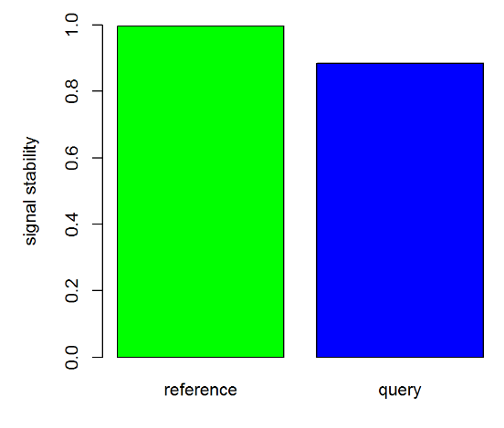
QC Benchmarker Implementation – Focus on automation and speed
Pre-run on server
Thermo
Agilent
Bruker
Sciex
Shimadzu
UIMF
drag and drop to website
200 ng HeLa
standard LC
standard MS/MS
query
Mass Spec?
reference
msconvert
msconvert
mzML
QC Material?
mzML
SpectraST search
PeptideProphet
comet
PeptideProphet
SpectraST -C create library
ID-free metrics
ID-based metrics
ID-free metrics
ID-based metrics
Notes:
Website:
Containerized Linux OS with R, Python, Redis and Celery
TPP (wine) used for conversion and identifications
Existing R packages: mzR, MSnbase, pepXMLTab

Slide 8
ID-free + ID-based metrics
Instead of plotting a predefined peptide or m/z across many datasets, we use machine learning to model the performance of the LC and the ion source, to give more actionable QC metrics for troubleshooting. We also strive to have one ID-based and one ID-free metric for each system component.
 | Sample | LC | Source | MS1 | MS2
ID-free | amount loaded on column | Peak-widths, peak capacity | stability | TIC | Total signal
ID-based | % spectra matched | pH of mobile phases | z-dist of PSMs | mass error | mass error; # PSMs
*there are more metrics than these

Slide 9
Development of QC Benchmarker
Standard sample,
LC gradient,
and acquisition parameters
Very stable
Performance of source to MS2 is verified during calibration
Problems
Pumps, column, mobile phases, system contaminants, etc.
Notes:
The development of data used for QC Benchmarker testing required using a standard sample, gradient and MS/MS. For now this has focused on thermos instruments and a 2 hour 200ng HeLa injection.
Generated ~70 runs specifically looking at:
Mobile phase pH (0.1% formic acid to no formic acid)
Different amounts of HeLa on column (50 to 1000 ng)
Sub-optimal collision energy
Attempted to degrade HeLa
Runs before and after MS cleaning
Attempted to decrease transfer efficiency
Mass error (couldn’t get over 8 ppm)
Running on a different platform (QE classic v Lumos)
15 runs across a year

Slide 10
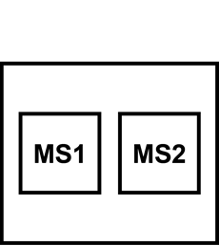
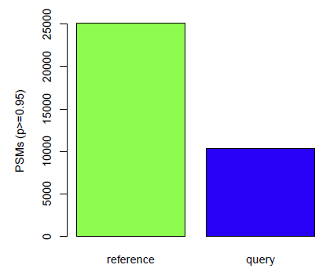
Example of a performance threshold – PSMs
Good
Thresholds are based on instrument and type of acquisition
Since each instrument is unique, qualitative thresholds may not be applicable, but metrics are still valid
Marginal
Bad

Slide 11
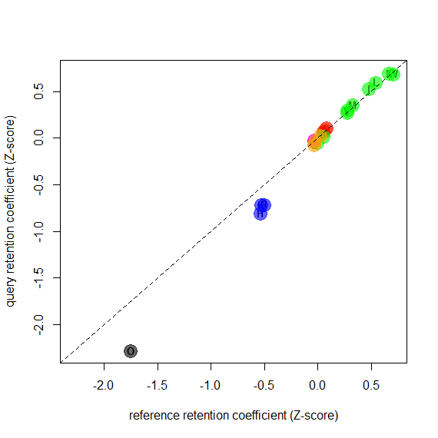
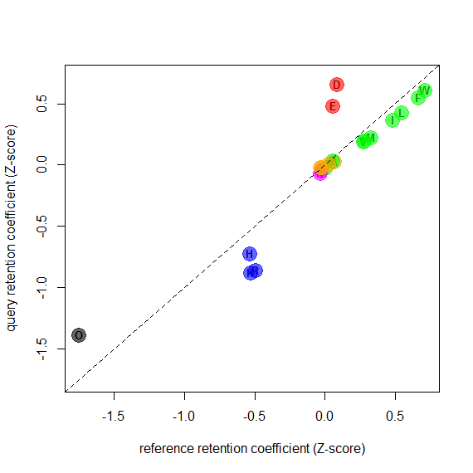
Machine Learning-based prediction of mobile phase pH and pump performance
acceptable
pH shift
Decreased correlation may indicate mobile phase pH is off
A deviation of the intercept indicates the pumps aren’t performing correctly
Palmblad et al., 2002 doi: 10.1021/ac0256890
Notes:
The retention coefficient of the residues when fit a linear model explaining retention time.
Too little acid, we see residues move (ex. the acidic moves more to neutral since around the pKa of residues.)
Even though pH changes, changes may indicate more buffering capacity
So the deviation from the line will indicate
No acid added and we see acidic/basic residues shift
If residues are linear, but shifted, the likely pumps

Slide 12
Autocorrelation-based peak width determination
Shifted all points by 50 ms
Notes:
First, what is autocorrelation, and start with lag-1
But lead into hot his can be used beyond lag-1

Slide 13
Autocorrelation-based peak width determination
30 second peak at base
FWHM = 11.7 sec
FWHM
Notes:
MSQC and QuaMeter emphasized quartiles for peak widths to give robust behavior in extreme variation. This is a similar mindset where we want to represent the whole gradient without being as influenced by peak shape.

Slide 14
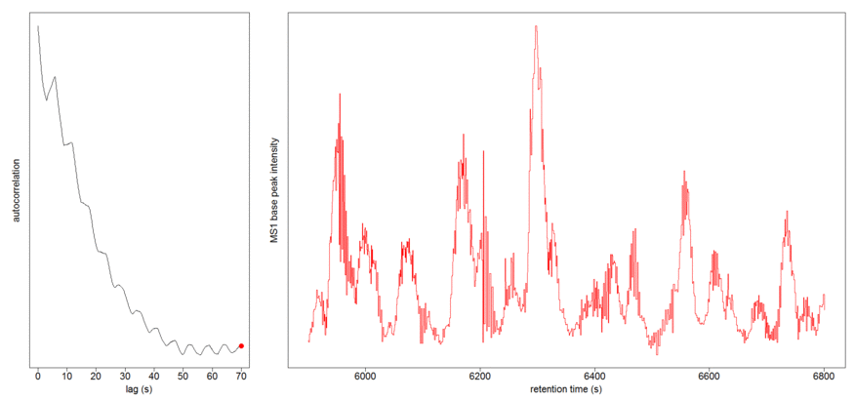
Autocorrelation-based peak width determination
Perform across the whole gradient
Mean FWHM
Notes:
Overcomes some limitations to peak fitting issues, and instead create a robust measure across the gradient

Slide 15
Autocorrelation-based measure of spray stability
Shifted all points by 50 ms

Slide 16
Autocorrelation-based measure of spray stability
Shifted all points by 50 ms

Slide 17
Autocorrelation-based measure of spray stability
The lag-1 autocorrelation generates a summary of peak stability across the run
Still working to determine what constitutes good, marginal or bad
Notes:
We are able to generate a metric related to stability across the whole run

Slide 18
ID-free + ID-based metrics
 | Sample | LC | Source | MS1 | MS2
ID-free | amount loaded on column | peak widths, peak capacity | stability | TIC | Total signal
ID-based | % spectra matched | pH of mobile phases | z-dist of PSMs | mass error | mass error; # PSMs
*there are more metrics than these

Slide 19
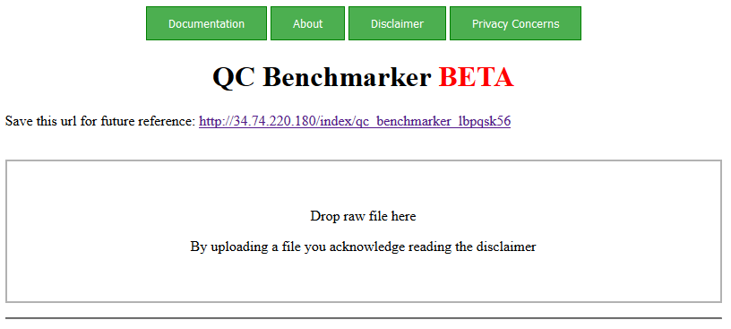
msqc.live
Notes:
Reporting:
Pipeline generates a high-level graphical summary and a detailed report
Allows easy communication of system suitability across labs and to users
Share electronic report
Share URL of relevant QC

Slide 20
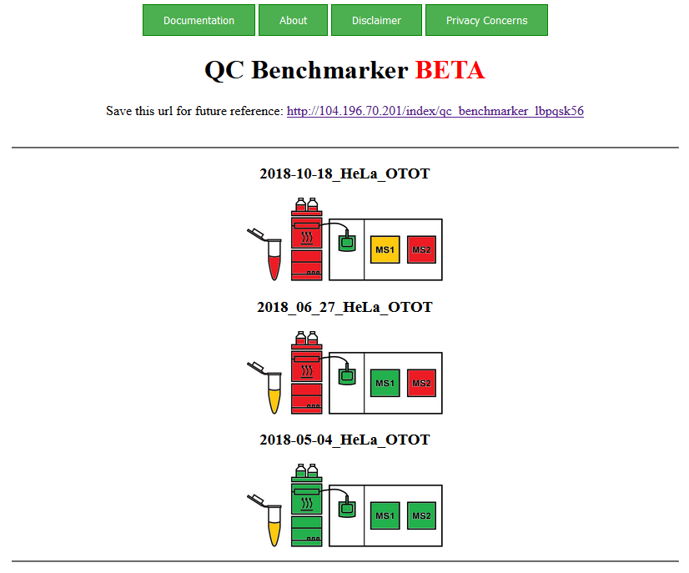
msqc.live
Notes:
Just click the colored regions to pull up the sub-reports.
Even though we didn’t focus on optimizing for mobile, this actually works pretty well on a small screen.
Also, I want to re-iterate that this URL is unique and can be shared with users or colleagues. In practice this can be very useful (similar btw to what AutoQC now provides)

Slide 21
Ongoing development (v1)
Summary statistics and figures related to more “classic” quality measures
Test on non-Thermo platforms
Generate data and test for Water’s E. coli and Promega Yeast
please recommend any commercially available digest
Establish relevant thresholds per platform
Allow for shorter gradients or different loading amounts
Model column heater effects and more pH data points
Future development (v2)
Allow user to specify thresholds
Allow user to import specific reference file (ex. experiment specific conditions and QC)
Locally evaluate temporal variations on large data sets
Evaluate mass spec-based metabolomics data

Slide 22
Questions

